Slide 1

2022 Year 7 Classifications ‘Identifying features of Animalia Phylums’
Written By Miss Serafino

Slide 2
Phylum's of Kingdom Animalia
There are multiple phylum's (categories) within the Kingdom Animalia. Within this lesson we will look at the following:
Poriferans
Platyhelminthes
Molluscs
Arthropods
Cnidarians
Nematodes
Echinoderms
Chordates

Slide 3
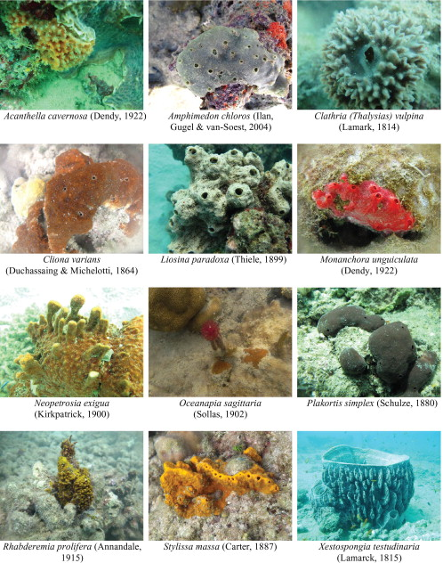
Poriferans
Pronounced “Por-if-er-ans”
Are the simplest multicellular organisms ‘sponges’ that are mainly found in marine habitats.
These organisms have a spongy body with pores and posses a canal system that helps the circulation of water (carrying oxygen) and food particles.

Slide 4
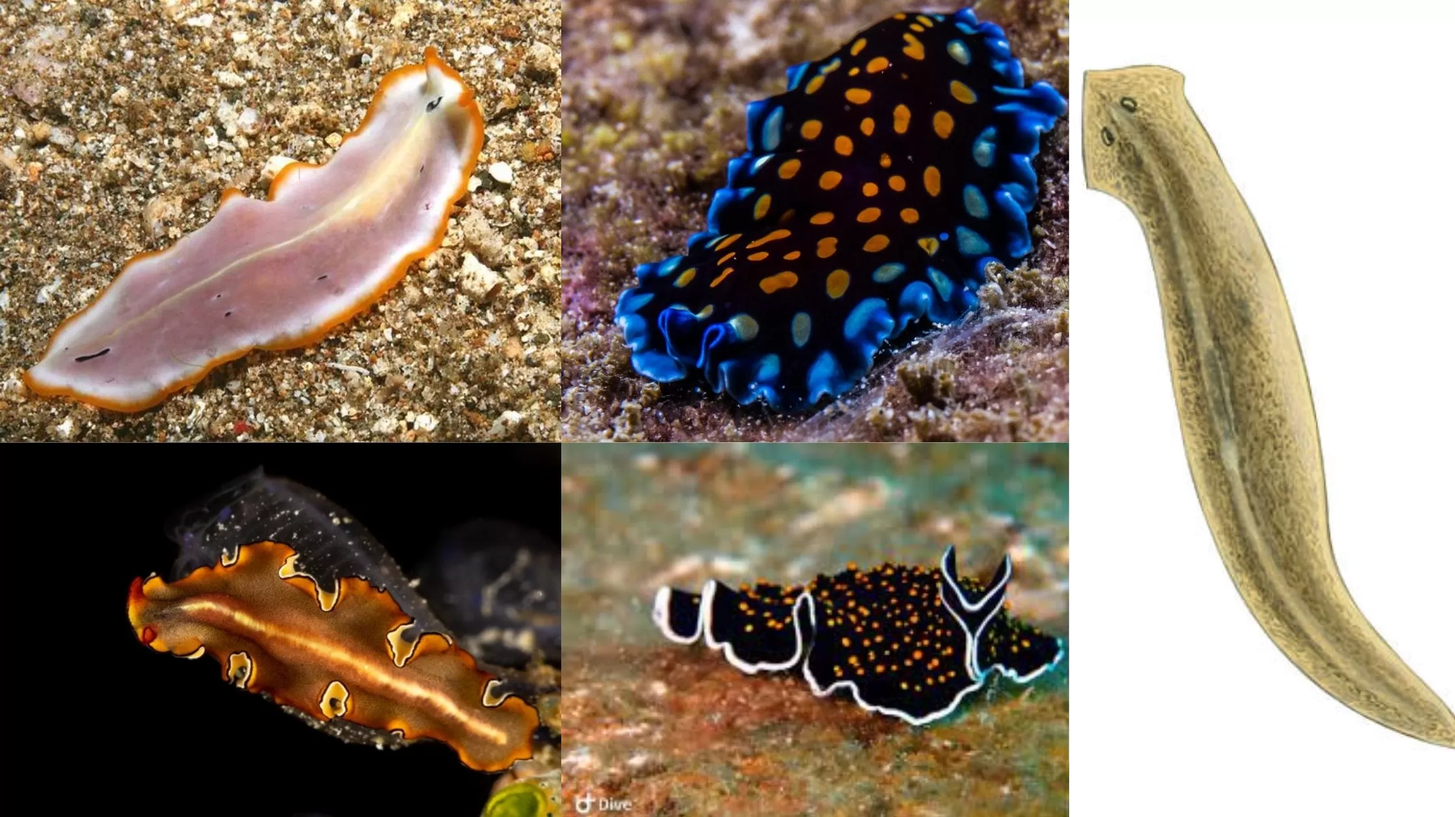
Platyhelminthes
Pronounced “Platy-hel-minthes”
Possess a soft, long and flattened body. The flat body is very noticeable.
Body is bilaterally symmetrical, which means both the left and right side of the body have the same design.
Examples include flatworms and tapeworms.

Slide 5
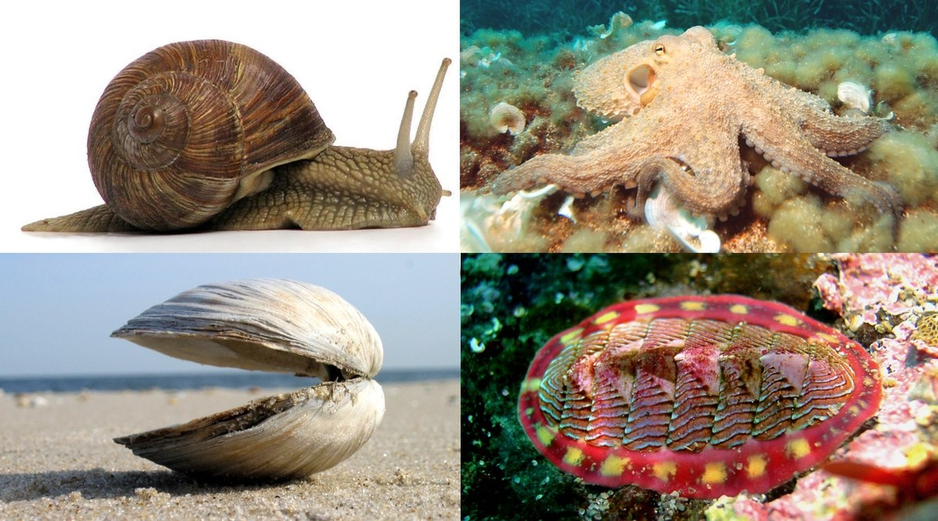
Molluscs
Pronounced “Moll-us-cs’
Possess a soft body that is unsegmented (not divided into different segments)
Usually have a protective shell.
Examples include octopus, snails, mussels and oysters.

Slide 6
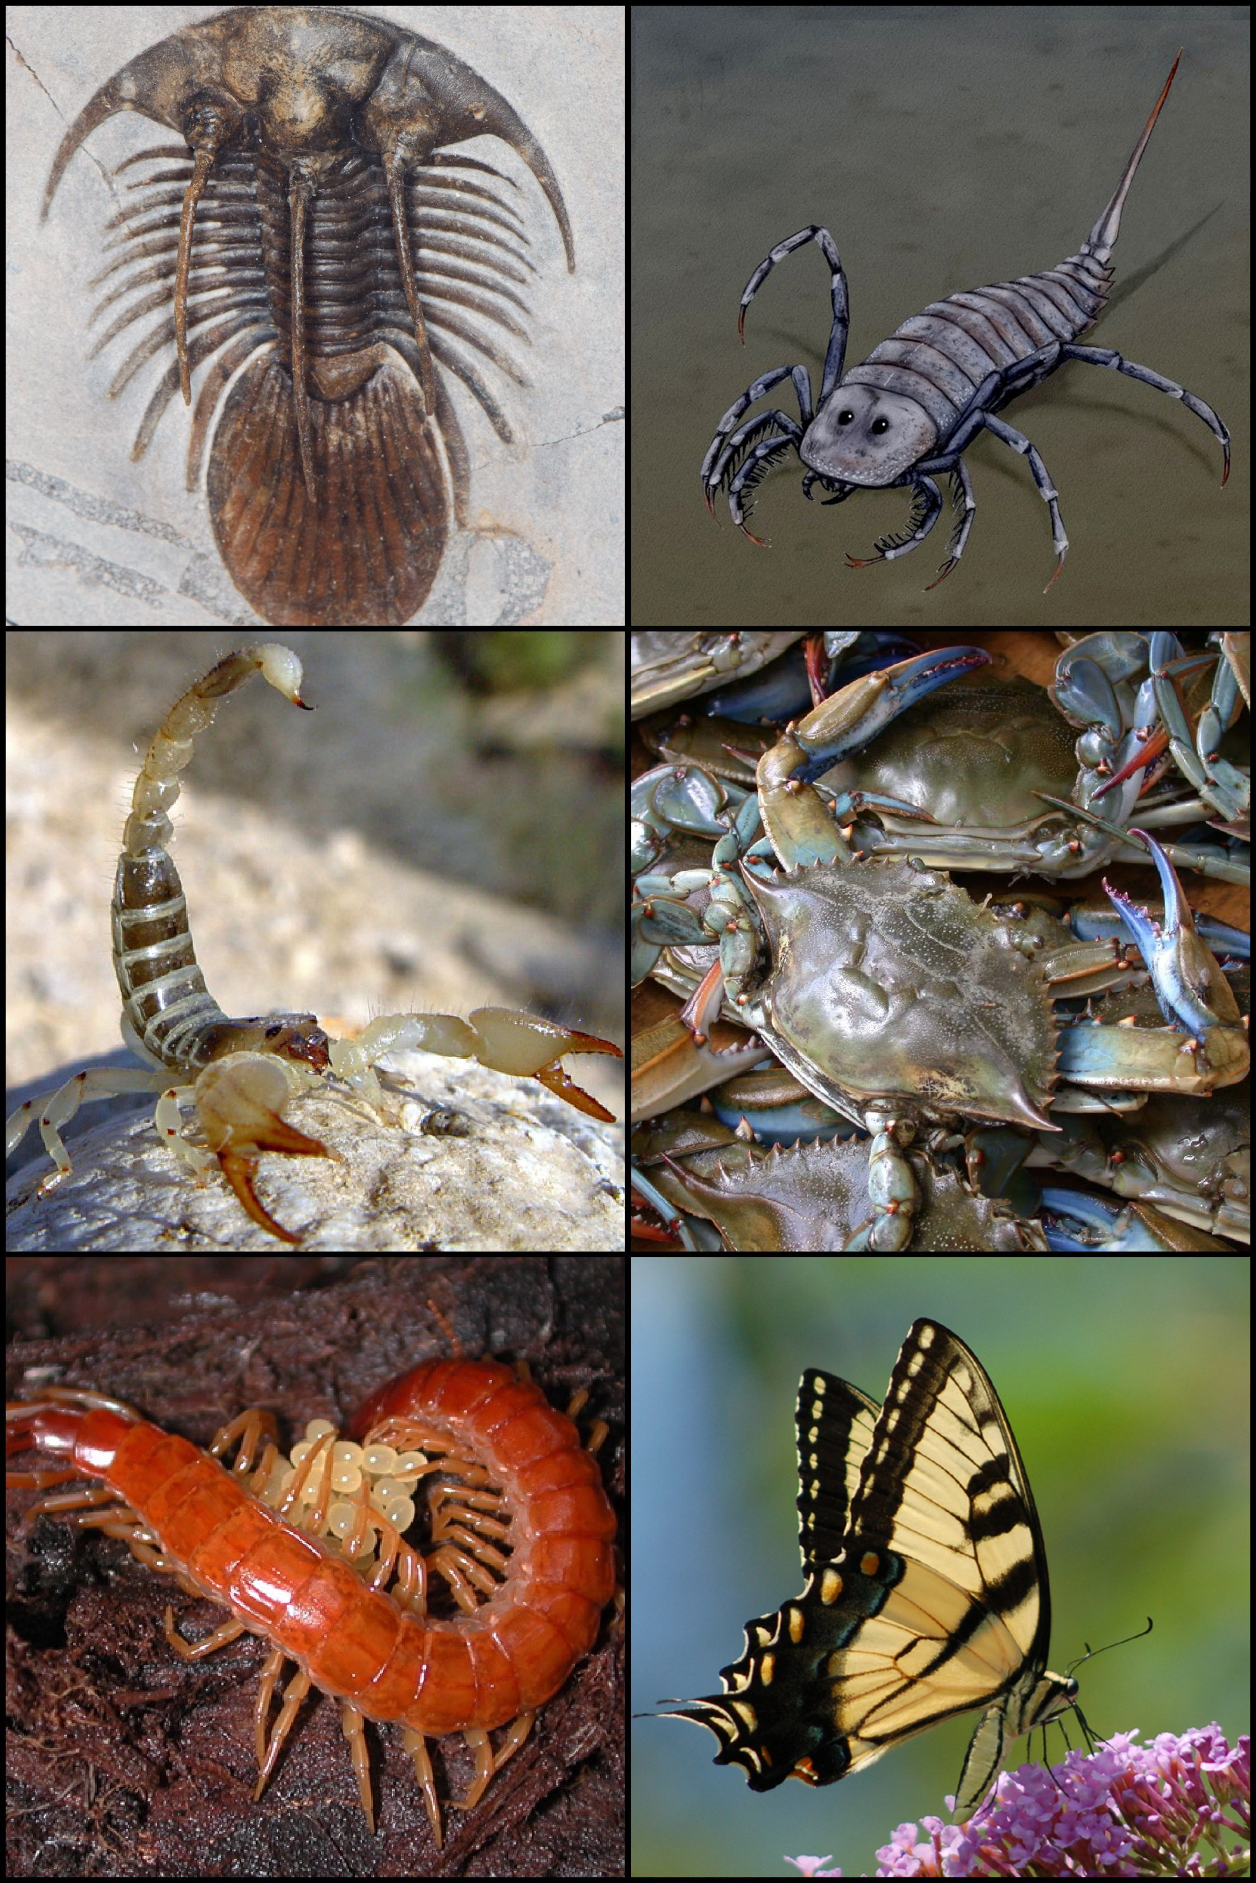
Arthropods
Pronounced “Arth-ro-pods”
Possess segmented bodies and have their legs paired/joined together.
Examples include spiders, scorpions, crabs, butterflys.

Slide 7
Student Task
Aim: create a poster in pairs categorising the correct animals in their phylum
Materials: Sheet of paper, scissors, glue, coloured texters
Method:
Select your partner to work with in creating your poster
Label your poster into the 4 phylum sections
Cut out the animals and glue them in the correct phylum
Colour in the animals and decorate your poster

Slide 8
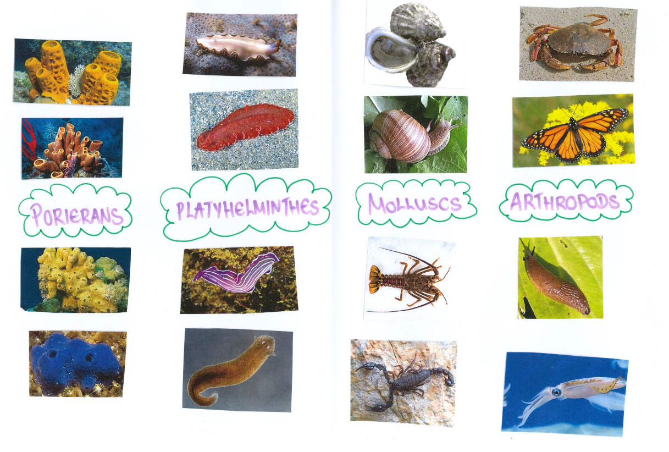
Student Task Example
Phylum’s within the Kingdom Animalia
By Miss Serafino

Slide 9
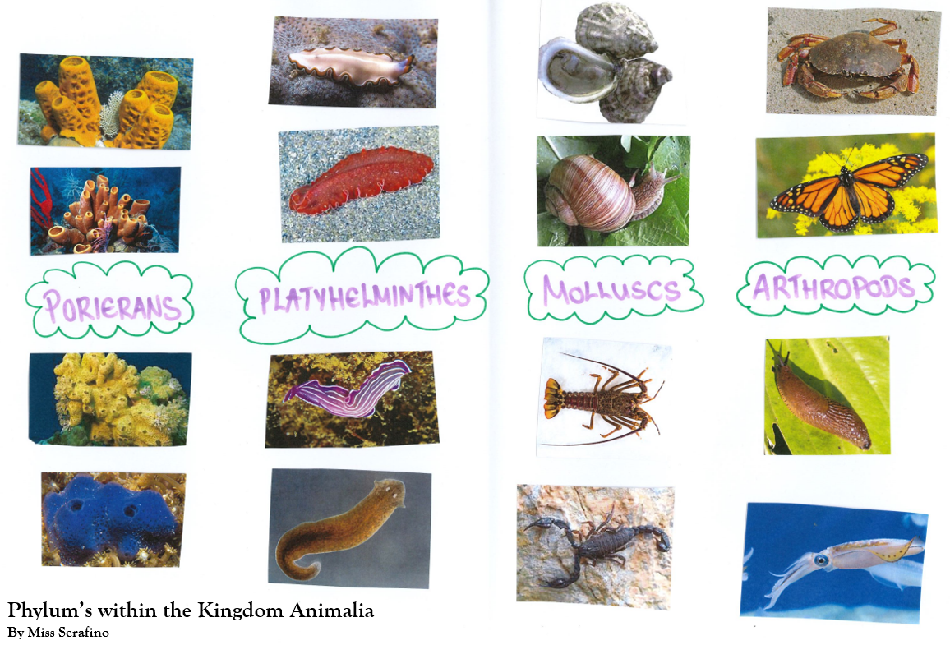
Student Task Checklist
Does my poster have a title?
→ Title: Phylum's within the Kingdom Animalia
Does my poster have the four phylum labels?
→ Poriferans, Platyhelminthes, Molluscs and Arthropods
Have we cut out all the animals?
Have we organised the animals into their phylum’s?
Have we glued the animals into their correct phylum’s listed on the poster?
Have we coloured in the animals?
Have we written our names on the poster?

Slide 10
Phylum's of Kingdom Animalia
There are multiple phylum's (categories) within the Kingdom Animalia. Within this lesson we will look at the following:
Poriferans
Platyhelminthes
Molluscs
Arthropods
Cnidarians
Nematodes
Echinoderms
Chordates

Slide 11
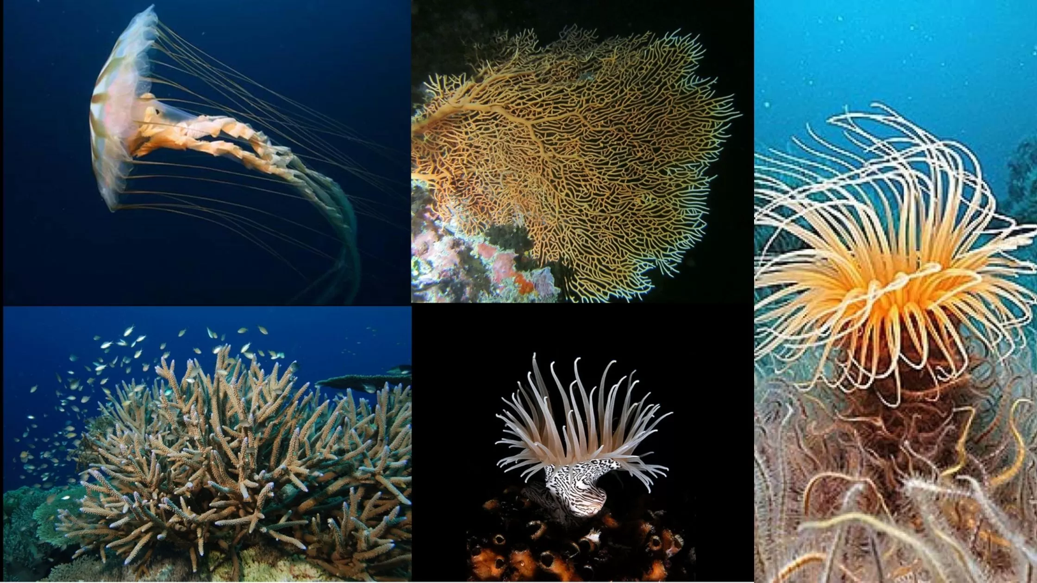
Cnidarians
Pronounced “Ni-dari-ans”
Possess a soft hollow body with tentacles.
Found in bot fresh and marine water environments.
Examples include jelly fish, anemone and coral.

Slide 12
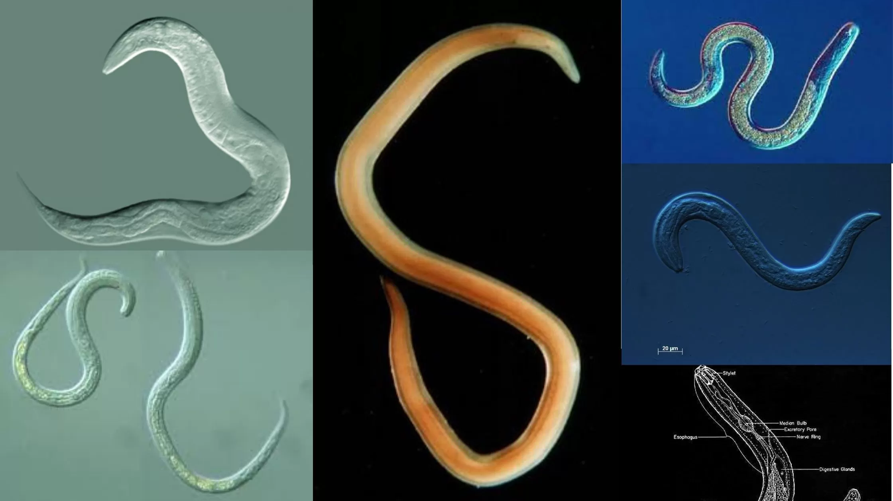
Nematodes
Pronounced “Nem-a-todes”
Possess a more cylindrical body shape, which is not flattened.
They are worms and examples include eelworm and ascaris.

Slide 13
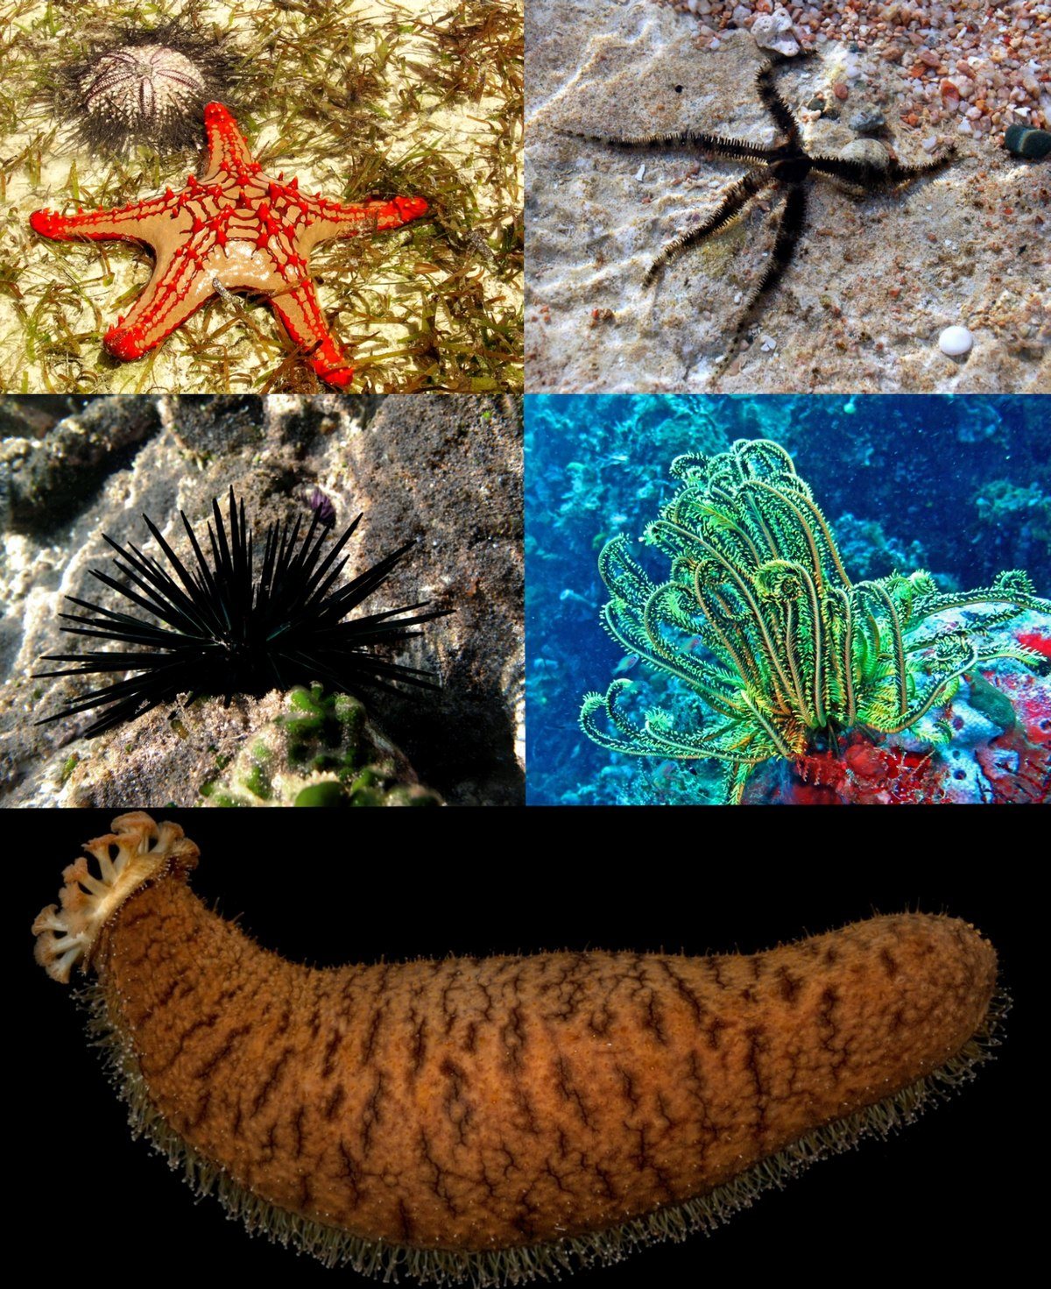
Echinoderms
Pronounced “Ech-ino-derms”
Found in the sea and possess rough, spiny skin.
Their arms radiate from the centre of their body.
Examples include star fish and sea urchins.

Slide 14
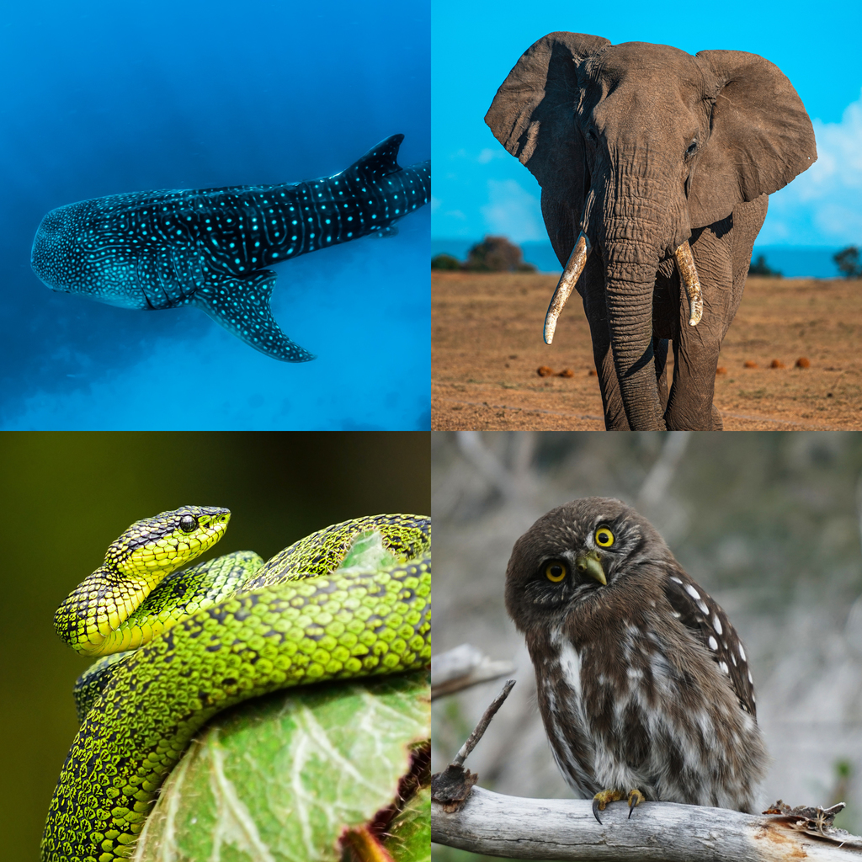
Chordates
Pronounced “Chor-dates”
Include a range of animals, such as some vertebrates, amphibians, reptiles, birds and mammals.
These animas must possess the five synapomorphies or primary characteristics at some point of their larval or adulthood stage:
Example animals include sharks, alligators, frogs.
a notochord
dorsal hollow nerve cord
endostyle or thyroid
pharyngeal slits,
A post-anal tail

Slide 15
Student Task Continued…
Aim: create a poster on the other side of your created poster in pairs categorising the correct animals in their phylum
Materials: Sheet of paper, scissors, glue, coloured texters
Method:
Select your partner to work with in creating your poster
Label your poster into the 4 phylum sections
Cut out the animals and glue them in the correct phylum
Colour in the animals and decorate your poster

Slide 16
Student Task Checklist
Does my poster have a title?
→ Title: Phylum's within the Kingdom Animalia
Does my poster have the four phylum labels?
→ Cnidarians, Nematodes, Echinoderms, Chordates
Have we cut out all the animals?
Have we organised the animals into their phylum’s?
Have we glued the animals into their correct phylum’s listed on the poster?
Have we coloured in the animals?
Have we written our names on the poster?

